Slide 1
Formation Creep
Observations
Practical implications
Way forward/potential
Lars Hovda, ConocoPhillips Wells
Bjørn Holien, ConocoPhillips Wells

Slide 2
Cautionary Statement
The following presentation includes forward-looking statements. These statements relate to future events, such as anticipated revenues, earnings, business strategies, competitive position or other aspects of our operations, operating results or the industries or markets in which we operate or participate in general. Actual outcomes and results may differ materially from what is expressed or forecast in such forward-looking statements. These statements are not guarantees of future performance and involve certain risks, uncertainties and assumptions that may prove to be incorrect and are difficult to predict such as oil and gas prices; operational hazards and drilling risks; potential failure to achieve, and potential delays in achieving expected reserves or production levels from existing and future oil and gas development projects; unsuccessful exploratory activities; unexpected cost increases or technical difficulties in constructing, maintaining or modifying company facilities; international monetary conditions and exchange controls; potential liability for remedial actions under existing or future environmental regulations or from pending or future litigation; limited access to capital or significantly higher cost of capital related to illiquidity or uncertainty in the domestic or international financial markets; general domestic and international economic and political conditions, as well as changes in tax, environmental and other laws applicable to ConocoPhillips’ business and other economic, business, competitive and/or regulatory factors affecting ConocoPhillips’ business generally as set forth in ConocoPhillips’ filings with the Securities and Exchange Commission (SEC). We caution you not to place undue reliance on our forward-looking statements, which are only as of the date of this presentation or as otherwise indicated, and we expressly disclaim any responsibility for updating such information.
Use of non-GAAP financial information – This presentation may include non-GAAP financial measures, which help facilitate comparison of company operating performance across periods and with peer companies. Any non-GAAP measures included herein will be accompanied by a reconciliation to the nearest corresponding GAAP measure on our website at www.conocophillips.com/nongaap.
Cautionary Note to U.S. Investors – The SEC permits oil and gas companies, in their filings with the SEC, to disclose only proved, probable and possible reserves. We use the term "resource" in this presentation that the SEC’s guidelines prohibit us from including in filings with the SEC. U.S. investors are urged to consider closely the oil and gas disclosures in our Form 10-K and other reports and filings with the SEC. Copies are available from the SEC and from the ConocoPhillips website.

Slide 3
Good to know
SPE # 96100 (capillary pressure)
SPE # 148640 (essentials of P&A)
SPE # 37263 (well bore stability with water based mud)
SPE # 119321 (bond log of formation barrier)
Fjær, E. Steinbråten, J.F.,2016: How Shale May form a Sealing Barrier around a Well, 5th EAGE Shale Workshop, Extended Abstract. DOI: 10.3997/2214-4609.201600415
The author acknowledges permission to publish the above presentation from ConocoPhillips Skandinavia AS and Co-venturers, including TOTAL E&P Norge AS, Eni Norge AS, Statoil Petroleum AS and Petoro AS

Slide 4
Motivation
If there was a proper cmt over the P&A interval – the P&A depth – the operation would be quicker and could potentially be done with a light equipment package.
There is a number of Ekofisk logs which show that the shale does not creep. But can we make that happen?

Slide 5
“Our shale does not creep”
Refer SPE 148640 (2011) for details of COP P&A operations and log:
  Concept of CUP type P/W/C is to find a open section (under P&A depth) and WASH same
  Open section implies that the shale have failed to seal the annulus
  Why?
    Wrong shale?
    P or T outside a critical value or envelope?
    Bad luck?
Based on previous experience COP position was (up to Q1, 2016):
  Our shale does not creep
  Maybe we can make it – maybe we can let it?
Note: This position was based on a P&A experience/bond logs mainly from sections drilled with mineral oil based mud, OBM.

Slide 6
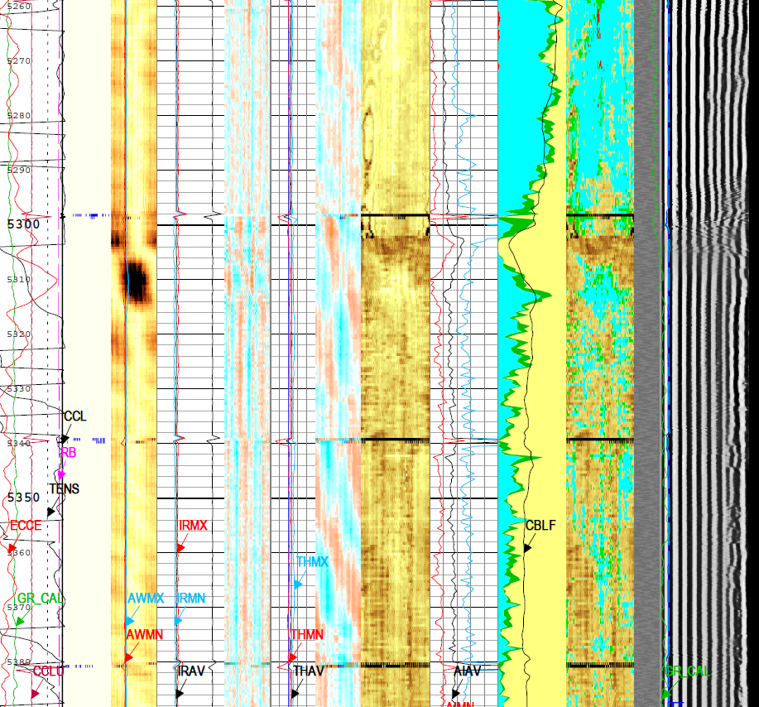
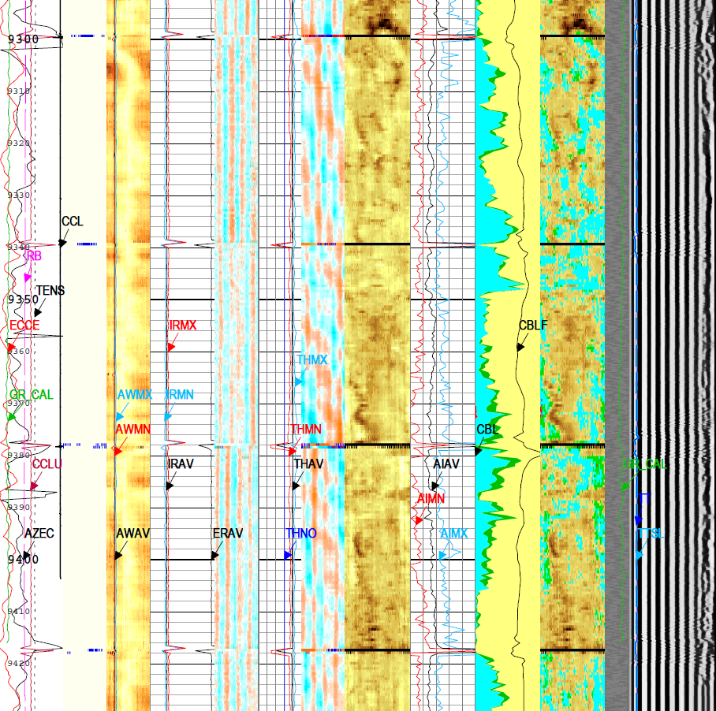
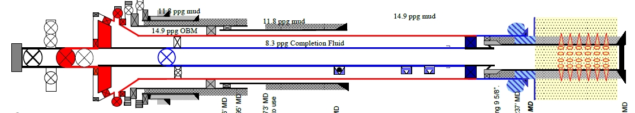
Proof: “Our shale does not creep”
Well 2/4 – XX, slot recovery and drill in 2005:
  Sidetrack through 13 3/8’’ casing
  11 ¾’’ liner installed at standard depth
  12 ¼“ section drilled with standard mineral oil based drilling fluid and the 9 5/8’’ was hung off just above reservoir
  9 5/8’’ cement job performed with heavy losses
  Mid string external casing packer – standard Ekofisk solution
Well was subject to a workover in 2014:
  Bond log 9 years after casing installation: no evidence of fm creep/self sealing annulus
  The main objective of bond log was to “find a suitable area” for P/W/C technique (ref SPE# 148640)
  Note the trapped annulus volume
Baseline log under 11 ¾’’ shoe (2014) | Baseline log @ +/- prod packer (2014)

Slide 7
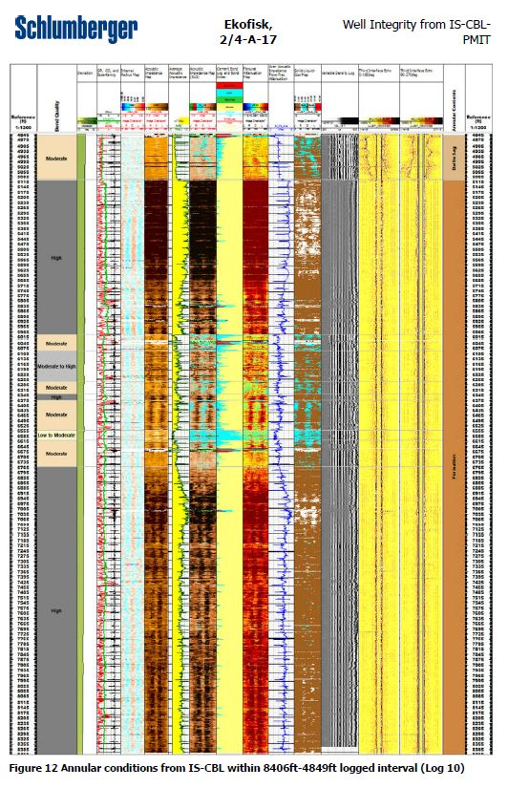
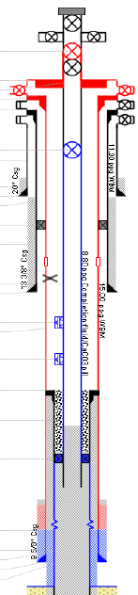
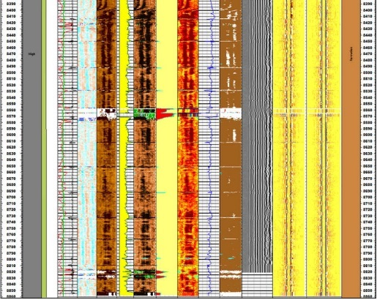
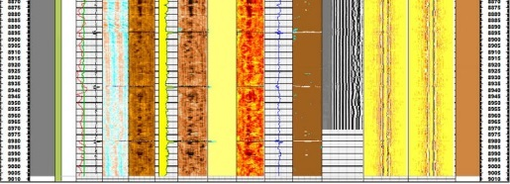
Maybe we can ‘’let our shale creep’’
Well 2/4 YY drilled in the early nineties:
  12 ¼“ section drilled with seawater based drilling fluid and the 9 5/8’’ was hung off just above reservoir
  9 5/8’’ cement job designed with low TOC
  Mid string external casing packer – standard Ekofisk solution
Well was subject to a P&A in 2016
  Bond log +/- 25 years after casing installation: All but diatomite zone showed a solid filled annulus
  Note the trapped annulus volume
With respect to log
  Confident we are not reading barite or cmt
  All readings are positive (VDL, USIT, flex attenuation, TIE disappears…)
With respect to the P&A technique
  This was a through tubing candidate (we did not know)
What made the fm seal of the open annulus?
13 3/8’’ csg shoe, 5008 ft mD
‘’open section’’ (diatomite)
Estimated top of barite
Log to TOL at +/- 9300 ft mD

Slide 8
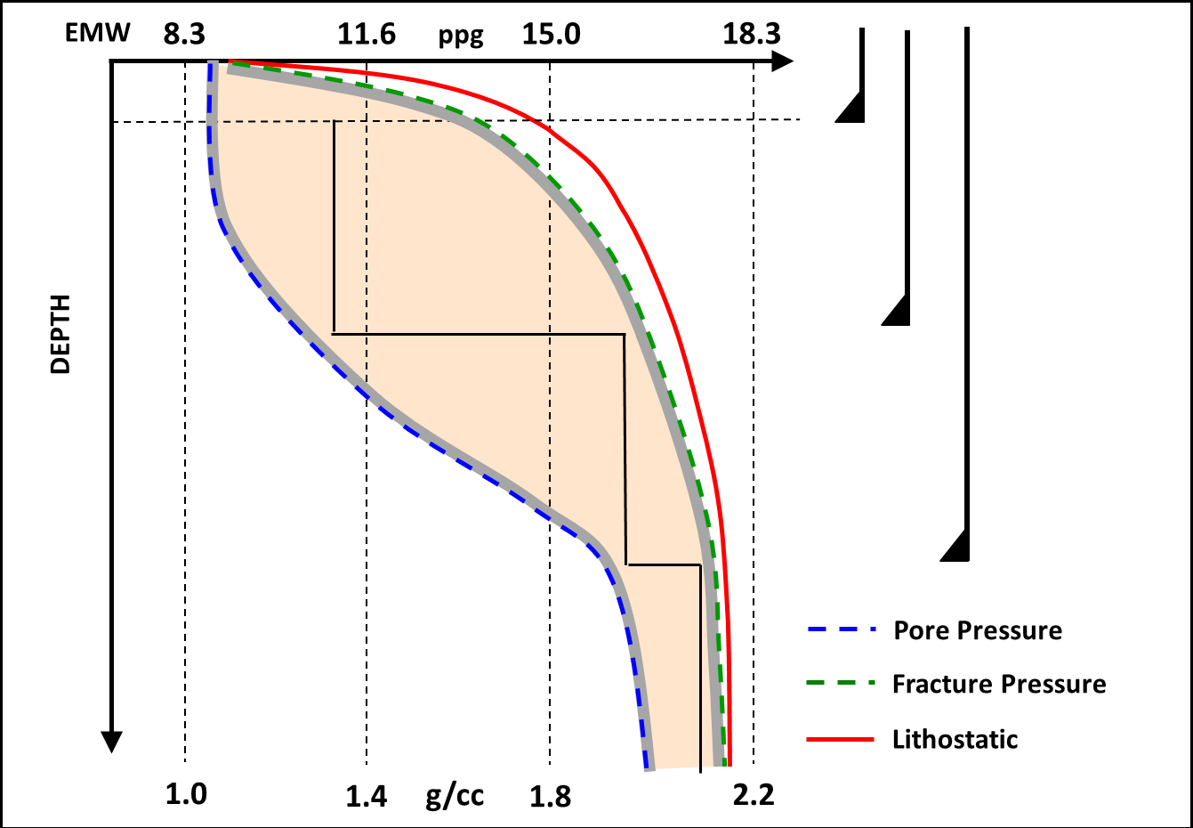
Trapped volume – escape options
Trapped volume – escape options:
Down towards a depleted reservoir (ref BP 2015 PAF presentation)
Into the matrix or a permeable layer fighting capillary pressure and or pore pressure
Into the matrix fighting frac pressure
Up annulus and out a gate valve
PP/FG plot from: https://www.ikonscience.com/solutions/drilling

Slide 9
Practical implications
For P&A operations:
To log or not to log (@ cost = 1 rig day)? Log
We have established a best practice for log and verification
Map P&A inventory vs. mud system
In a research perspective:
Communicated Ekofisk observations
Inhouse work to release Ekofisk overburden core for SINTEF JIP
We need to study “entry pressure”
Decision made/preparations and testing ongoing:
Radical changes to P/W/C technique
This includes testing of a SW based mud system
Objective is to “buy” a fm creep insurance (+++)

Slide 10
Way forward/potential
In a research perspective:
  Understand fm creep mechanisms
  Understand implications connected to well design
  Understand opportunities to activate fm creep in a P&A operation
In operation perspective:
  Understanding of mechanisms + dual string logging => through tubing P&A?
  Understanding of mechanisms + equipment package => cost effective intervention based P&A?
  Change well design and or fluids program on new wells?

Slide 11
QUESTIONS?

