Slide 1
Criteria for On-The-Fly Frac Water Treatment with ClO₂

Slide 2
Overview
Water Sources and Characteristics of Water Used in Fracs
Water Components Which Cause Problems
The Impact of ClO₂ on These Species
Practical Issues
Conclusions

Slide 3
Sources of Water Used in Fracs
Rivers/streams
Groundwater/Wells
Lakes/Impoundments
Acid Mine Drainage
Municipal (treated) Water Supplies
Flowback/Produced Water

Slide 4
River Water Characteristics
Parameter
TDS (ppm)
Range of Values for Rivers
Chattahoochee (Atlanta)
33
Colorado (Los Angeles)
661

Slide 5
Produced Water Characteristics
Parameter
TDS max (ppm)
Sulfides (ppm)
Iron (ppm)
Play
Marcellus
200,000 +
0 - ?
varies
Barnett
150,000
0 - ?
varies

Slide 6
Marcellus Flowback Water Characteristics
Parameter
pH
TDS (ppm)
Chloride ppm (as Cl⁻)
Sulfate ppm (as SO₄⁻²)
Sodium ppm (as Na)
Calcium ppm (as Ca)
Magnesium ppm (as Mn)
Barium ppm (as Ba)
Strontium ppm (as Sr)
Iron ppm (as Fe)
Day 1
6.97
21823
13600
0
6270
1180
129
276
204
8
Marcellus
Day 5
6.42
65976
40600
0
17700
4760
492
1340
890
21
Day 14
6.1
201860
125300
2
47800
23321
2336
248
2396
277

Slide 7
Problem Causing Species
  Bacteria – Corrosion, Plugging, Production of H₂S
  Biofilm – Corrosion, Plugging
  H₂S – Corrosion, Souring of Reservoir
  FeS – Corrosion, Plugging
  Hardness Salts – Deposit/Scale, Plugging
  Barium Salts – Deposit Formation, Plugging
  NORM - Environmental

Slide 8
Impact of ClO₂ on Problematic Species
  Bacteria – Very Effective.
  Biofilm – Very Effective
  H₂S – Very Effective
  FeS – Very Effective
  NORM - ClO₂ can reduce the amount of NORM¹
  Hardness Salts – No Direct Effect
  Barium – No Effect
¹ Mason, J., Block, R. and Knippers, M., "Reduction of Naturally Occurring Radioactive Material Disposal Volume by Chemical and Physical Treatment," SPE 24563, 67th Annual Technical Conference and Exhibition of the Society of Petroleum Engineers, Washington, DC, October 4-7, 1992

Slide 9
ClO₂ & Bacteria
1. Penetration
Penetration of the cell wall is the rate limiting step
ClO₂
The bacterial cell wall thickness varies. Spores are much more resistant to disinfection than bacteria.
Bacterial Cell Wall
ClO₂ was chosen to inactivate anthrax spores in DC.
It is the penetration factor that makes one bacteria more or less resistant to inactivation.^{1,2}
1. McDonnell, G. and Russell, A., "Antiseptics and Disinfectants: Activity, Action, and Resistance," Clinical Microbiology Reviews, 12(1), 147(1999).
2. Ingols, R. and Ridenour, G., "Chemical Properties of Chlorine Dioxide," Journal of the American Water Works Association, 40, 1207(1948).
Notes:
The literature indicates that it is the penetration factor that makes one bacteria more or less resistant to inactivation. Consequently bacterial spores, which have a hard outer coat, are more resistant to penetration. This makes bacterial spores arguably the most difficult bacterial organism to inactivate.
Because it is uncharged, ClO2 is equally soluble in organics and water. Actually, it is about 4 X more soluble in cyclohexane than in water.
In addition, when used to disinfect RO water, the ClO2 slips right through the RO membrane.
In this way, the ClO2 rapidly penetrates through a bacterial cell wall.
There is a “pecking order” of the relative ease by which bacteria are inactivated. This is a well known phenomenon in potable water applications and is referred to as the “CT” factor.
CT factor is the concentration in mg/L times the contact time in minutes. Every disinfectant has a CT factor for a given bacterium.

Slide 10
ClO₂ & Bacteria
2. Oxidation of Vital Cell Components
some amino acids
proteins
enzymes
O
O
very fast
S
ClO₂ + R-S-H ➔
R
OH
The affinity of ClO₂ for reduced sulfur compounds, specifically the sulfhydryl group (-S-H), has also been suggested as one mode of bacterial disinfection.^{1,2} And although the focus of the papers cited below is on chlorine, since ClO₂ both penetrates better and has a significantly greater affinity for reduced sulfur compounds than chlorine, it is valid to extend this mechanism to ClO₂.
1. Green, D. and Stumpf, P., "The Mode of Action of Chlorine," Journal of the American Water Works Association, 38, 1301(November, 1946).
2. Knox W., Stumpf, P., Green, D., and Auerbach, V., "The Inhibition of Sulfhydryl Enzymes as the Basis of the Bacterial Action of Chlorine," Journal of Bacteriology, 55,451(1948).
Notes:
Several mechanisms have been put forth for the inactivation of bacteria by ClO2.
The one I favor is the one that shows the disruption of some vital cell component, polymer, enzyme, amino acid, or protein, by the extremely fast reaction of ClO2 with reduced sulfur components, such as the sulfhydryl functional group, which is found on a number of amino acids which are building blocks of proteins and viruses in living organisms.
This mechanism is also a favorite of some researchers to explain the disinfection mechanism of chlorine as shown in the references cited.

Slide 11
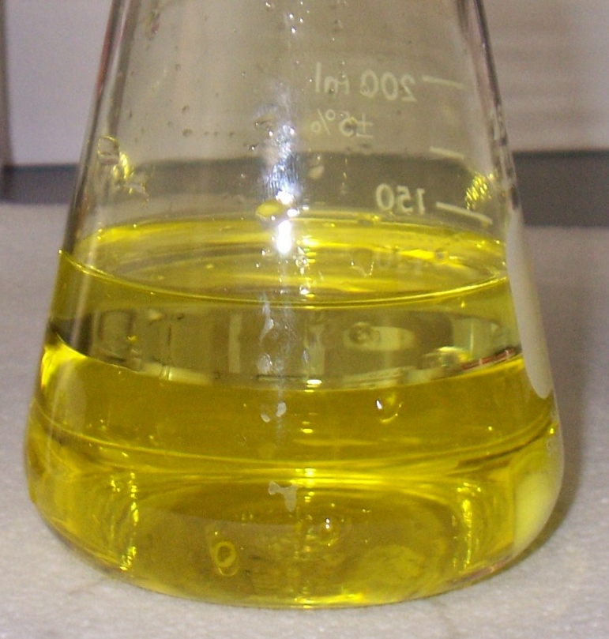
ClO₂ & Biofilm
ClO₂ is uncharged and relatively non-polar.
ClO₂ is ~ 4X more soluble in cyclohexane than it is in water.
Hexane Layer
Water
Layer
2 – 3 seconds
Notes:
This slide shows the results of one experiment. An ~ 3000 ppm solution of ClO2 was made. Then, n-hexane was poured very slowly into this flask, with the flask held sideways to minimize mixing. Despite the care with which this was done, within just a few seconds, the hexane layer on top was almost as yellow as that of the water. This indicated that the ClO2 very rapidly penetrated into the organic layer.
Chlorine will never do this.
In fact, ClO2 is about 4 times more soluble in cyclohexane than it is in water. This shows the relative ease with which ClO2 penetrates organic material, and explains why ClO2 is so effective on biofilm.

Slide 12
ClO₂ & Biofilm
ClO₂ reacts with...
Bacteria in the bulk water
Biofilm and Biofilm Bacteria on system surfaces. For ClO₂, one must account for surface demand.
Bulk Water Bacteria
Bacterial Biofilm and Associated Bacteria
Notes:
In any system there are two types of ClO2 demand. The first is bulk water demand. This can be measured and will be described in more detail later.
The second is the demand for ClO2 created by the biofilm on solid surfaces in the system.
One can measure the demand in the bulk water. But one can’t measure the demand on the surface. The surface demand must be determined empirically. That is, treatment dosage must be adjusted to account for the demand on the surfaces.

Slide 13
ClO₂ & Biofilm
Cl2 Residual
Pipe
Bleach or Cl₂
No ClO2
Residual Until
Pipe Walls Clean
Pipe
ClO2
Notes:
This slide shows graphically what happens with ClO2 vs what happens with Cl2.
As mentioned on the previous slide, one of the key performance characteristics for ClO2 is, unlike chlorine, its ability to penetrate readily into organics. Because chlorine doesn't penetrate, the biofilm must be "burned" off. This is a slow process.
Consequently ClO2 does not differentiate much between whether it is inactivating bacteria in the bulk water or whether it is inactivating bacteria in biofilm. The net result is that when ClO2 is applied to a system, ClO2 will move through the system, rather like plug flow, disinfecting the bulk water and removing biofilm at pretty much the same time.
Cl2 is charged and highly polar. Consequently it will not penetrate into the organic layer very well at all. It works primarily by chewing off chunks of biofilm and is a relatively slow process.
For example
In one potable water application, the manager of the facility said that if he injected Cl2 into the water, as soon as that water got to the end of the distribution system, 26 miles away, he could measure a Cl2 residual.
Then, a change to ClO2 was made. It took 4-5 months for a residual to reach the end of the distribution system. The reason? Unlike Cl2, ClO2 was consumed by stuff on the walls of the piping.
In every industrial system where observation could be made, this phenomenon has occurred.

Slide 14
ClO₂ & H₂S
XS ClO₂ in produced water
5H₂S + 8ClO₂ + 4H₂O
5H₂SO₄ + 8HCl
Strong Mineral Acids
If the water is highly buffered, and if the sulfide concentration is relatively low, the oxidation of sulfide by ClO₂ will have minimal impact on pH.
If the water is not highly buffered, and if the sulfide concentration is moderate, then the application may result in a pH depression.
Typically, we see a 0.1 – 1 unit reduction in pH.
Notes:
One of the very important performance characteristics of ClO2 is its affinity for reduced sulfur compounds.
For example, when ClO2 reacts with H2S, strong mineral acids are formed. In alkaline solution, it is theoretically possible for elemental sulfur to be formed, as shown in the second equation.
Practically, though, the production of strong mineral acids by the reaction moves the pH rapidly into the acidic region, so that formation of elemental sulfur is not normally observed.

Slide 15
ClO₂ & H₂S
Insufficient ClO₂ in neutral to alkaline solution
2H₂S + 2ClO₂
H₂SO₄ + 2HCl + S°
Elemental Sulfur
Possible
From a corrosion standpoint, feeding an insufficient amount of ClO₂ can result in a higher corrosion rate than feeding none.
Notes:
One of the very important performance characteristics of ClO2 is its affinity for reduced sulfur compounds.
For example, when ClO2 reacts with H2S, strong mineral acids are formed. In alkaline solution, it is theoretically possible for elemental sulfur to be formed, as shown in the second equation.
Practically, though, the production of strong mineral acids by the reaction moves the pH rapidly into the acidic region, so that formation of elemental sulfur is not normally observed.

Slide 16
ClO₂ & FeS
5FeS + 9ClO₂ + 2H₂O
5Fe⁺³ + 5SO₄⁻² + 9Cl⁻ + 4H⁺
Converts insoluble Fe_{x}S_{y} to soluble iron sulfate.
Notes:
Dissolved iron sulfide, or finely divided iron sulfide, is rapidly oxidized by ClO2. The iron is oxidized from the soluble ferrous (+2 valence) to the insoluble ferric (+3 valence) state.
Note that FeS is shown in the above equation, although there are many forms of FexSy that are known.
Again, the equation shows the production of elemental sulfur, although in practice this is not normally observed.

Slide 17
Practical Issues
Residuals Required for Bacterial Inactivation
The Importance of Contact Time
Residuals Required for Biofilm Control/Removal
The Critical Nature of a Proper Demand Study
  The Importance of Selecting the Right Injection Point
  The Importance of Monitoring
  The Importance of Feedback Control
  Real-Time Reporting
  Conclusions
Notes:
As long as there is a slight residual of ClO2, bulk water disinfection will occur. The key is the maintenance of a slight residual over a long time. So, contact time is pretty essential for bulk water bacterial inactivation.
In contaminated water, i.e., water that has a lot of components that will consume ClO2, but consume it slowly, it is important to maintain a ClO2 residual for a sufficient amount of time so that bacterial inactivation can occur.
This required contact time may be extended when the water has a lot of suspended solids. Bacteria are known to hide in suspended solids. Bacteria are also known to "clump" together, so that while bacteria on the outside may be inactivated by ClO2, it may take some time for the ClO2 to penetrate the "clump."
This is why, when doing a demand study, which I will talk about later, contact time is critical.

Slide 18
Practical Issues – Residual for Bacteria
As long as the treatment dosage equals or exceeds bulk water demand slightly, bulk water disinfection will occur.*
* This statement is true for clean systems, with few suspended solids. Bacteria are known to "hide" in suspended solids and biofilm fragments, so unless 1 – 3 ppm ClO₂ residual can be maintained for a sufficient contact time (> 3 minutes), bacteria can survive treatment. See following slide discussing the importance of contact time.
Notes:
As long as there is a slight residual of ClO2, bulk water disinfection will occur. The key is the maintenance of a slight residual over a long time. So, contact time is pretty essential for bulk water bacterial inactivation.
In contaminated water, i.e., water that has a lot of components that will consume ClO2, but consume it slowly, it is important to maintain a ClO2 residual for a sufficient amount of time so that bacterial inactivation can occur.
This required contact time may be extended when the water has a lot of suspended solids. Bacteria are known to hide in suspended solids. Bacteria are also known to "clump" together, so that while bacteria on the outside may be inactivated by ClO2, it may take some time for the ClO2 to penetrate the "clump."
This is why, when doing a demand study, which I will talk about later, contact time is critical.

Slide 19
Practical Issues – Residuals and Contact Time for Disinfection of Bulk Water
For oil field produced and flowback water, 1 – 2 ppm ClO₂ residual needs to be maintained for at least 3 minutes in order to ensure bacterial inactivation.¹⁻³
NL Treating Chemicals,"'Generated DiKlor Products Training Manual," 1985.
Exxon Chemicals, Surface Applications of Generated DiKlor Products, 1989.
PureLine Treatment Systems, "CT for Achieving Effective Bacterial Inactivation in Produced/Flowback Water," unpublished internal report, 2014.
Notes:
It should be noted that there is a difference between the optimum dosages required for inactivating bulk water bacteria and bacteria found within biofilm.
Ideally, while only a slight positive residual is required for disinfection, generally, it will take at least 1 ppm of ClO2 residual to prevent/inactivate/dissolve biofilm bacteria.
For many oil field applications, especially on-the-fly frac jobs, ClO2 is fed with insufficient contact time. Therefore to accommodate the short contact time, the residual must be increased.
It is for this reason that most oil field ClO2 suppliers maintain a minimum of 5 ppm residual and some maintain a higher residual.

Slide 20
ClO₂ Required for Inactivation of Bulk Water Bacteria in Produced Water
6
SRB
APB
5
4
3
Log₁₀ Bacteria (cfu/mL)
2
2 mg/L threshold for bacterial inactivation
1
0
0.1
0
2
4
6
8
10
12
[ClO₂] Residual (mg/L)
Notes:
This slide shows why a 2 mg/L residual was set as the target.
After a large number of dose-response tests run in the field (significantly more than shown here), the data shows that if a 2 mg/L can maintained for a specific period of time, we always show very good bacterial control.

Slide 21
Practical Issues – Residual for Biofilm
To treat for biofilm, treatment needs to be at least 1 ppm over demand. Because of the high level of contamination in produced/flowback water, we typically shoot for 3 - 5 ppm over demand.
Notes:
It should be noted that there is a difference between the optimum dosages required for inactivating bulk water bacteria and bacteria found within biofilm.
Ideally, while only a slight positive residual is required for disinfection, generally, it will take at least 1 ppm of ClO2 residual to prevent/inactivate/dissolve biofilm bacteria.
For many oil field applications, especially on-the-fly frac jobs, ClO2 is fed with insufficient contact time. Therefore to accommodate the short contact time, the residual must be increased.
It is for this reason that most oil field ClO2 suppliers maintain a minimum of 5 ppm residual and some maintain a higher residual.

Slide 22
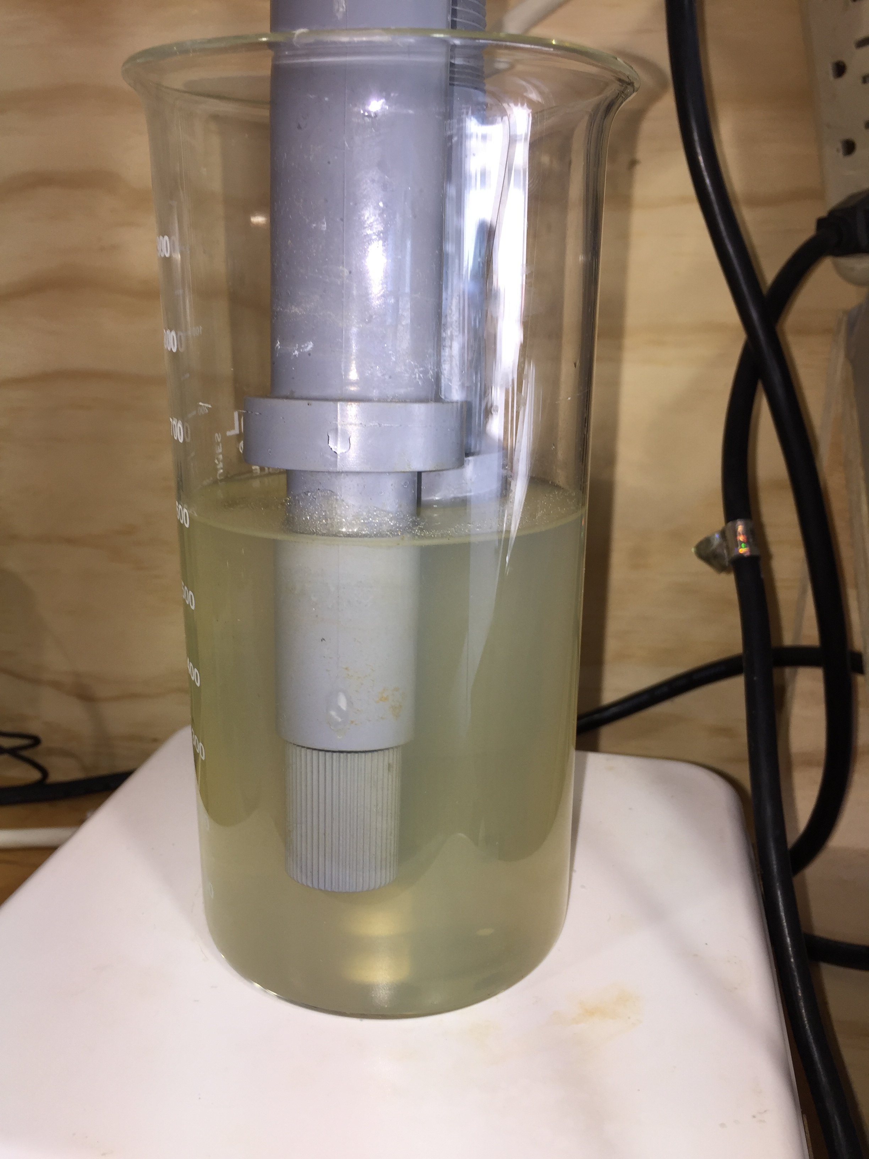
Practical Issues – Demand Testing
Experimental Setup
Two ORP Probes
Data recorded every 15 secs
ClO₂ Solution Standardized Immediately Before Use
ClO₂ Added in 5 ppm Doses
Notes:
It should be noted that there is a difference between the optimum dosages required for inactivating bulk water bacteria and bacteria found within biofilm.
Ideally, while only a slight positive residual is required for disinfection, generally, it will take at least 1 ppm of ClO2 residual to prevent/inactivate/dissolve biofilm bacteria.
For many oil field applications, especially on-the-fly frac jobs, ClO2 is fed with insufficient contact time. Therefore to accommodate the short contact time, the residual must be increased.
It is for this reason that most oil field ClO2 suppliers maintain a minimum of 5 ppm residual and some maintain a higher residual.

Slide 23
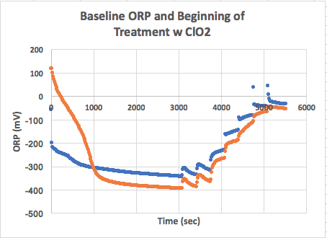
Practical Issues – Demand Testing
5 ppm ClO₂ Addition
Notes:
It should be noted that there is a difference between the optimum dosages required for inactivating bulk water bacteria and bacteria found within biofilm.
Ideally, while only a slight positive residual is required for disinfection, generally, it will take at least 1 ppm of ClO2 residual to prevent/inactivate/dissolve biofilm bacteria.
For many oil field applications, especially on-the-fly frac jobs, ClO2 is fed with insufficient contact time. Therefore to accommodate the short contact time, the residual must be increased.
It is for this reason that most oil field ClO2 suppliers maintain a minimum of 5 ppm residual and some maintain a higher residual.

Slide 24
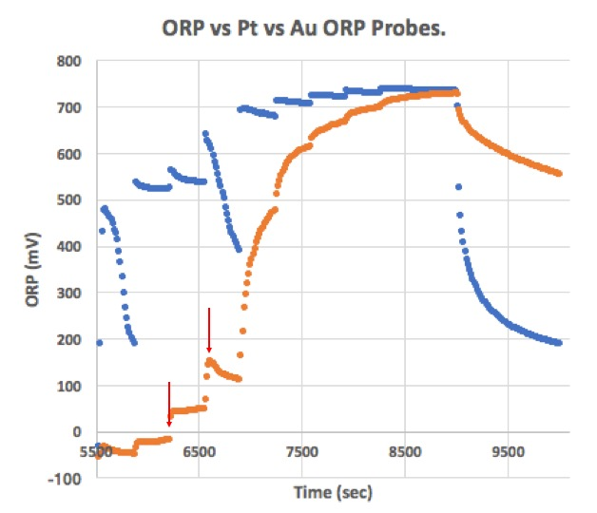
Practical Issues – Demand Testing
80 ppm ClO₂ Addition = 10.5 ppm ClO2 residual after 5 minutes
5 ppm ClO₂ Addition
75 ppm ClO₂ Addition = ~ 5 ppm ClO2 residual after 5 minutes
Notes:
It should be noted that there is a difference between the optimum dosages required for inactivating bulk water bacteria and bacteria found within biofilm.
Ideally, while only a slight positive residual is required for disinfection, generally, it will take at least 1 ppm of ClO2 residual to prevent/inactivate/dissolve biofilm bacteria.
For many oil field applications, especially on-the-fly frac jobs, ClO2 is fed with insufficient contact time. Therefore to accommodate the short contact time, the residual must be increased.
It is for this reason that most oil field ClO2 suppliers maintain a minimum of 5 ppm residual and some maintain a higher residual.

Slide 25
Practical Issues - Injection / Sampling Point
Spool
Untreated Water to Frac
Working Frac Tanks
Treated Water to Frac
Blender
ClO₂ Injection Point
~ 5-minute reaction time from point of injection to monitor
ClO₂ Residual Monitoring
Stream
ClO₂ Motive Water
ClO₂ Generator
ClO₂ Monitor
Typical Fresh Water Dosage ~1.5 – 10 ppm (~ 3 – 5 ppm residual)
Typical Produced Water Dosage ~ 10 - 150 ppm (every application is different)
Notes:
The ClO2 must be monitored after about 5 minutes of reaction time. Period.

Slide 26
Practical Issues – Monitoring at the Right Sample Point and Contact Time
Knowing the ClO₂ residual is critical.
This requires real-time on-line electronic monitoring of the ClO₂ residual.
On-line electronic monitored must be backed up by wet chemical testing of grab samples.
Notes:
It should be noted that there is a difference between the optimum dosages required for inactivating bulk water bacteria and bacteria found within biofilm.
Ideally, while only a slight positive residual is required for disinfection, generally, it will take at least 1 ppm of ClO2 residual to prevent/inactivate/dissolve biofilm bacteria.
For many oil field applications, especially on-the-fly frac jobs, ClO2 is fed with insufficient contact time. Therefore to accommodate the short contact time, the residual must be increased.
It is for this reason that most oil field ClO2 suppliers maintain a minimum of 5 ppm residual and some maintain a higher residual.

Slide 27

Practical Issues – Monitoring & Control
Real-time on-line monitoring allows the ClO₂ generator to respond rapidly to unexpected changes in water quality and flow.
70
60
In this application, the working tanks were dirty. Because of the way monitoring was done, the ClO₂ generator responded by increasing treatment until a 3 – 5 ppm residual was achieved downstream of the tanks.
50
40
ClO₂ Dosage (ppm)
30
20
10
1
2
3
4
5
6
7
8
9
10
11
12
13
14
0
Stage
Notes:
This illustrates the importance of reaction time, AND automatic monitoring.
The ClO2 residual, if monitored manually, read about 5 ppm, with a 10 ppm dosage.
But when the water went into the frac tanks, there was a lot of sludge or material in the tanks that consumed ClO2.
Automatic monitoring AFTER the tanks resulted in the generator ramping up considerably to insure that the residual out of the frac tanks was about 5 ppm.
As the frac proceeded, the frac tanks began to clean up, and the required application dosage declined correspondingly.
After the third stage, the applied dosage had declined to a steady state dosage which remained constant during the completion of this well.
This illustrates the importance of both reaction time, automatic monitoring, and monitoring at the proper place.

Slide 28
Practical Issues – What Happens If
If monitoring is done before the working tanks...
70
60
...then it will take, according to this real-world example, 10 stages before the ClO₂ meets the demand of both bulk water and sludge in working tanks. Thus 10 of 14 stages will not receive well-disinfected water.
50
40
ClO₂ Dosage (ppm)
30
20
10
1
2
3
4
5
6
7
8
9
10
11
12
13
14
0
Stage
Notes:
This illustrates the importance of reaction time, AND automatic monitoring.
The ClO2 residual, if monitored manually, read about 5 ppm, with a 10 ppm dosage.
But when the water went into the frac tanks, there was a lot of sludge or material in the tanks that consumed ClO2.
Automatic monitoring AFTER the tanks resulted in the generator ramping up considerably to insure that the residual out of the frac tanks was about 5 ppm.
As the frac proceeded, the frac tanks began to clean up, and the required application dosage declined correspondingly.
After the third stage, the applied dosage had declined to a steady state dosage which remained constant during the completion of this well.
This illustrates the importance of both reaction time, automatic monitoring, and monitoring at the proper place.

Slide 29
Practical Issues – Real-Time Reporting
What Kind of Information Do You Want or Need?
  water flows of all loops?
  pH values for all loops?
  electronically measured ClO₂ residuals at all monitoring points?
  manually measured ClO₂ residuals at all monitoring points?
  precursor usage rates for each generator?
  ClO₂ generation rates?
  anything else that is useful can be provided
To be able to sit at your desk and get a snapshot of what is going on in the field in real-time saves time and provides transparency. You don't have to worry that the work is being done properly.
Notes:
Allowing the producer to have access to data generated in reall-time by an automated feed and control system. This allows the producer to Trust, but Verify

Slide 30
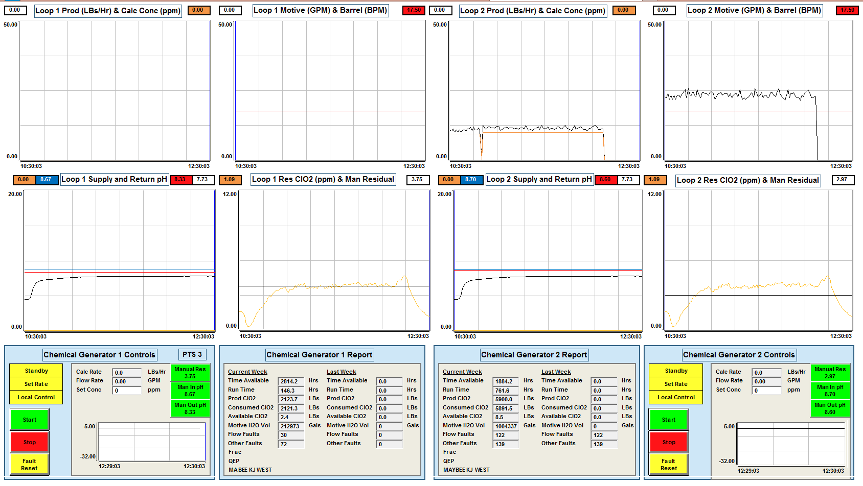
Example – Analog Overview

Slide 31
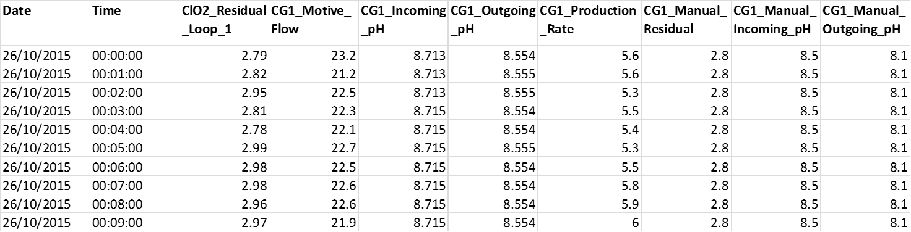
Example - Digital Overview

Slide 32
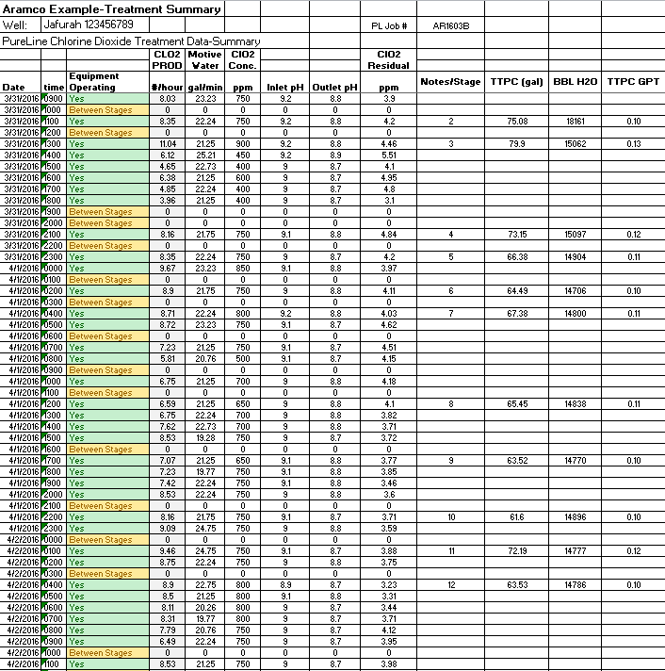
Example -Treatment Summary

Slide 33
Example –
Precursor
Usage

Slide 34
Conclusions
ClO₂ Addresses Several Important Water Contaminants Through Known Mechanisms
  bacteria
  bacterial biofilm
  H₂S
  FeS
Demand Testing is Critical
Sample and Monitoring Points are Critical to Ensure Sufficient Contact Time
Transparency in Reporting is Important
Notes:
Allowing the producer to have access to data generated in reall-time by an automated feed and control system. This allows the producer to Trust, but Verify

Slide 35
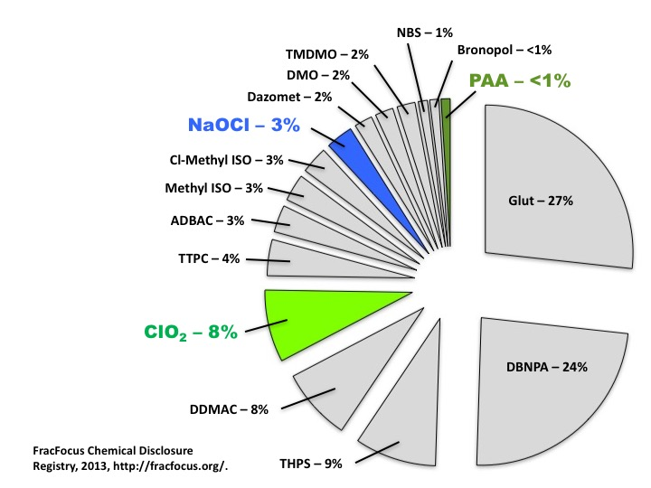
Conclusions
ClO₂ – 8%
Others report the number may be as high as 20%.¹
Relative use of ClO₂ is increasing.
1. King, G., “Hydraulic Fracturing 101: What Every Representative, Environmentalist, Regulatory, Reporter, Investor, University Researcher, Neighbor and Engineer Should Know About Estimating Frac Risk and Improving Frac Performance in Unconventional Gas and Oil Wells,” SPE 152596, SPE Hydraulic Fracturing Technology Conference, The Woodlands, Texas, February 6-8, 2012.
Notes:
Allowing the producer to have access to data generated in reall-time by an automated feed and control system. This allows the producer to Trust, but Verify

Slide 36
Thank You
Questions?

